Slide 1
Investigation of a gel effect on dental disease by Generalized Linear Model
Lingdi Zhang
09-12-2018

Slide 2
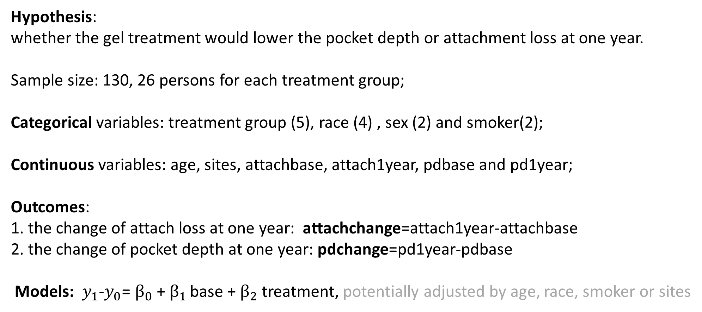
Introduction of dataset
Hypothesis:
whether the gel treatment would lower the pocket depth or attachment loss at one year.
Sample size: 130, 26 persons for each treatment group;
Categorical variables: treatment group (5), race (4) , sex (2) and smoker(2);
Continuous variables: age, sites, attachbase, attach1year, pdbase and pd1year;
Outcomes:
1. the change of attach loss at one year: attachchange=attach1year-attachbase
2. the change of pocket depth at one year: pdchange=pd1year-pdbase
Models: $y_{1}$-$y_{0}$= $β_{0}$ + $β_{1 }$base +${ β}_{2}$ treatment, potentially adjusted by age, race, smoker or sites

Slide 3
Statistical descriptions of the dataset
1. correlation
New outcome:
Attachchange
pdchange

Slide 4
Statistical descriptions of the dataset
2. Missing data
3. Mean for continuous variables

Slide 5
4. Frequency for categorical variables

Slide 6
The analyzed result by GLM and t-teat
treatment | P-value | treatment | P-value
Trt1&2 | 0.0883 | Trt2&3 | 0.0174
Trt1&3 | 0.3706 | Trt2&4 | 0.0096
Trt1&4 | 0.2733 | Trt2&5 | 0.5735
Trt1&5 | 0.3981
Trt1: Placebo
Trt2: control
Trt3: Low concentration active ingredient gel
Trt4: Medium concentration active ingredient gel
Trt5: High concentration active ingredient gel

Slide 7
Conclusion and Limitation
GLM of attachchange
GLM of pdchange
From above results, adjusted by demographic factors, the new gel had no significant effect on the treatment population, and was not promising to test for clinical trial. But baseline may affect attach loss (p<.0001), and sex may affect pocket depth (p=0.033).
If the population increased, the model might be more accurate and the clinical significance might be much better addressed. It was difficult to impute the accurate values for the missing data since there was only one year data point and did not know the reason for loss of following up.

Slide 8
Conclusion and Limitation
Conclusion:
The average change of attach loss was statistical significance (P=0.0451) among the five treatment groups, specifically between control group and low concentrations (P=0.0174), or medium concentrations group(P=0.0096). However, the Placebo group had not significant difference from all other groups. The results might show that brushing the study gel on the gum with active ingredient, had no significant difference from the gel without any active ingredient. The new gel might not have much clinical significance.
The new gel did not lower the pocket depth since there was no significant difference (P=0.0899) for the five treatment groups.
Limitation:
The number of the precipitants was small, 26 samples in each treatment group. If the population increased, the model might be more accurate and the clinical significance might be much better addressed. Since the small group in the data, it was difficult to impute the accurate values for the missing data. Also the missing data were missing by random, and it was hard to track the reason and conditions for the persons who failed to show up at one year.

